Slide 1
STA4211 Project
Jonathan Lee

Slide 2
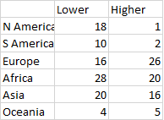
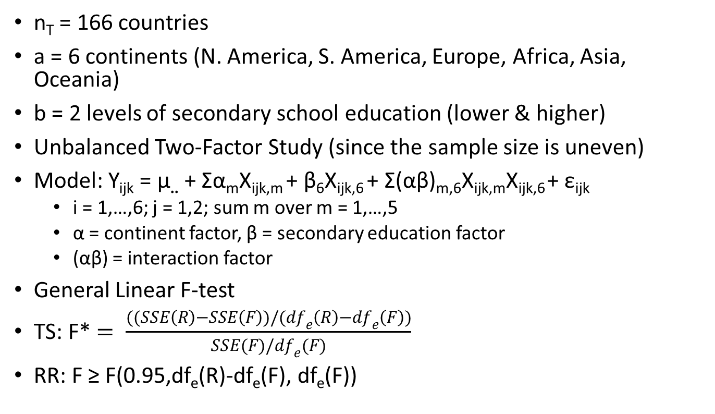
A study on GDP per capita across the world
n_{T} = 166 countries
a = 6 continents (N. America, S. America, Europe, Africa, Asia, Oceania)
b = 2 levels of secondary school education (lower & higher)
Unbalanced Two-Factor Study (since the sample size is uneven)
Model: Y_{ijk} = µ.. + Σα_{m}X_{ijk,m} + β₆X_{ijk,6} + Σ(αβ)_{m,6}X_{ijk,m}X_{ijk,6} + ε_{ijk}
i = 1,…,6; j = 1,2; sum m over m = 1,…,5
α = continent factor, β = secondary education factor
(αβ) = interaction factor
General Linear F-test
TS: F* $= \frac{((SSE\left(R\right)−SSE\left(F\right))/({df}_{e}\left(R\right)−{df}_{e}\left(F\right))}{SSE(F)/{df}_{e}(F)}$
RR: F ≥ F(0.95,df_{e}(R)-df_{e}(F), df_{e}(F))

Slide 3
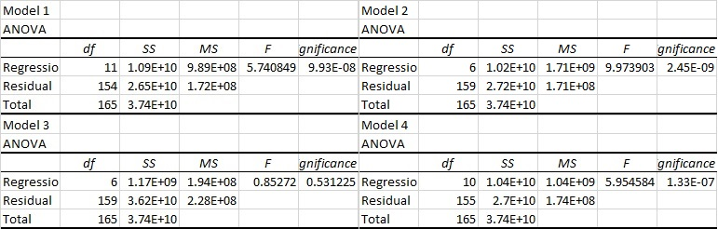
Results of the General Linear F-tests
Test for interaction effect:
F* = 0.7538, RR: F* ≥ F(0.95,5,154) = 2.273, p-value = 0.5845 (no significant interaction effect)
Test for continent main effects:
F* = 11.276, RR: F* ≥ F(0.95,5,154) = 2.273, p-value ≤ 0.0001 (there is a significant continent effect)
Test for secondary school education main effects:
F* = 2.8809, RR: F* ≥ F(0.95,1,154) = 3.903, p-value = 0.092 (no significant secondary school effect)

Slide 4
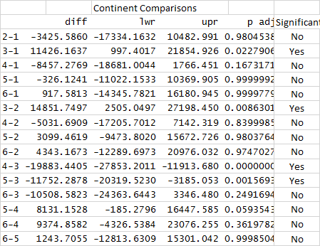
Tukey’s Comparisons for Continent Means
Tukey’s comparisons for 6 pairs of continents
15 different comparisons
Four pairs of continent means were significant
Continent 3 (Europe) & Continent 1 (N. America)
Continent 3 (Europe) & Continent 2 (S. America)
Continent 4 (Africa) & Continent 3 (Europe)
Continent 5 (Asia) & Continent 3 (Europe)
All other pairs were not significantly different

Slide 5
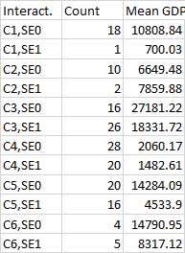

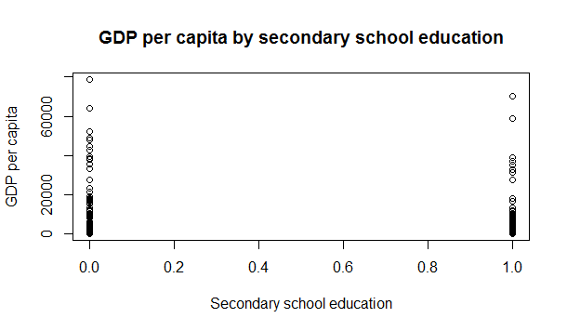
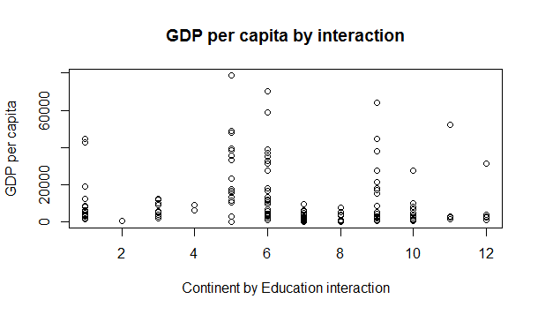
Conclusions: Education and Interaction
Secondary school education does not have a significant effect on a country’s GDP
There is not a significant continent by education interaction effect

Slide 6
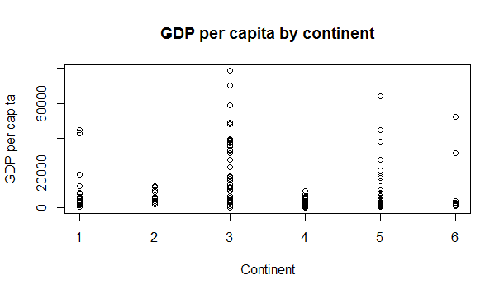
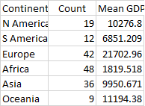
Conclusions: Continent Effect
A country’s continent has a significant effect on GDP
European countries have a significantly higher GDP than countries in other continents

